Slide 1
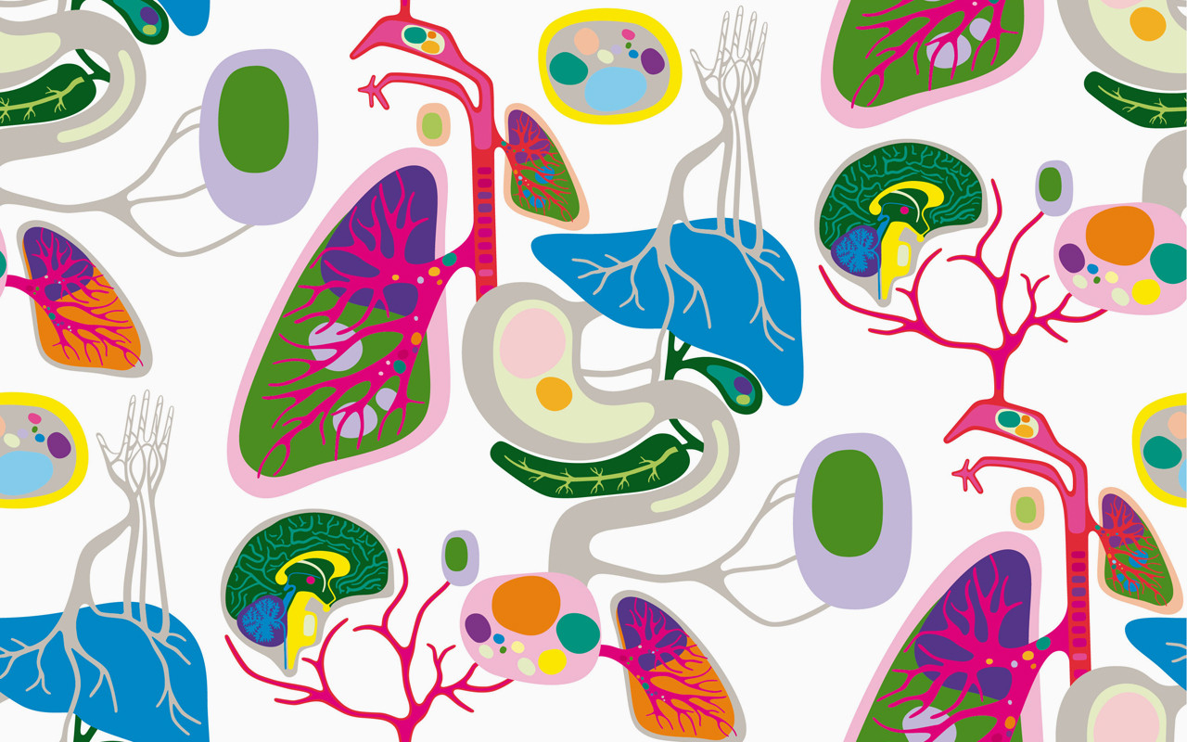
Biology for Engineers Course Code:21BE45

Slide 2
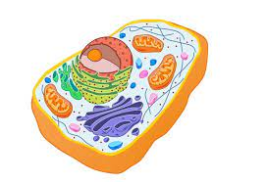
CELL-The Unit of life
What is a Cell?
A cell is the structural and fundamental unit of life. The study of cells from its basic structure to the functions of every cell organelle is called Cell Biology. Robert Hooke was the first Biologist who discovered cells.
All organisms are made up of cells. They may be made up of a single cell (unicellular), or many cells (multicellular). Mycoplasmas are the smallest known cells. Cells are the building blocks of all living beings. They provide structure to the body and convert the nutrients taken from the food into energy.
Cells are complex and their components perform various functions in an organism. They are of different shapes and sizes, pretty much like bricks of the buildings. Our body is made up of cells of different shapes and sizes.
Cells are the lowest level of organization in every life form. From organism to organism, the count of cells may vary. Humans have more number of cells compared to that of bacteria.
Cells comprise several cell organelles that perform specialized functions to carry out life processes. Every organelle has a specific structure. The hereditary material of the organisms is also present in the cells.

Slide 3
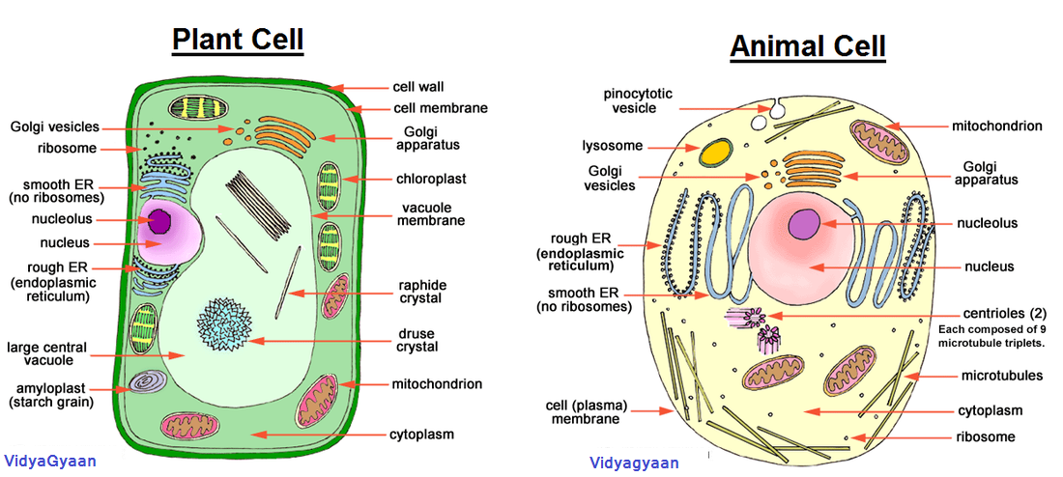
Structure of Plant and Animal cell

Slide 4
Characteristics of Cells
Following are the various essential characteristics of cells:
Cells provide structure and support to the body of an organism.
The cell interior is organized into different individual organelles surrounded by a separate membrane.
The nucleus (major organelle) holds genetic information necessary for reproduction and cell growth.
Every cell has one nucleus and membrane-bound organelles in the cytoplasm.
Mitochondria, a double membrane-bound organelle is mainly responsible for the energy transactions vital for the survival of the cell.
Lysosomes digest unwanted materials in the cell.
Endoplasmic reticulum plays a significant role in the internal organization of the cell by synthesizing selective molecules and processing, directing and sorting them to their appropriate locations.

Slide 5
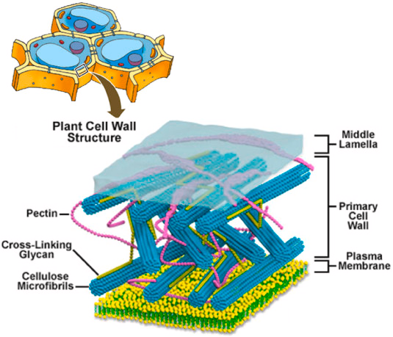
What is a Plant Cell?
Plant cells are eukaryotic cells that vary in several fundamental factors from other eukaryotic organisms. Both plant and animal cells contain a nucleus along with similar organelles. One of the distinctive aspects of a plant cell is the presence of a cell wall outside the cell membrane.
Plant Cell Structure
Just like different organs within the body, plant cell structure includes various components known as cell organelles that perform different functions to sustain itself. These organelles include:
Cell Wall
It is a rigid layer which is composed of polysaccharides cellulose, pectin and hemicellulose. It is located outside the cell membrane. It also comprises glycoproteins and polymers such as lignin, cutin, or suberin.
The primary function of the cell wall is to protect and provide structural support to the cell. The plant cell wall is also involved in protecting the cell against mechanical stress and providing form and structure to the cell. It also filters the molecules passing in and out of it.

Slide 6
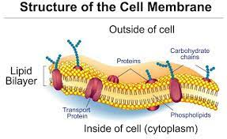
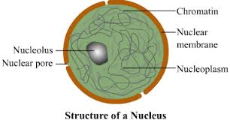
Cell membrane
It is the semi-permeable membrane that is present within the cell wall. It is composed of a thin layer of protein and fat.
The cell membrane plays an important role in regulating the entry and exit of specific substances within the cell.
For instance, cell membrane keeps toxins from entering inside, while nutrients and essential minerals are transported across.
Nucleus
The nucleus is a membrane-bound structure that is present only in eukaryotic cells. The vital function of a nucleus is to store DNA or hereditary information required for cell division, metabolism and growth.

Slide 7
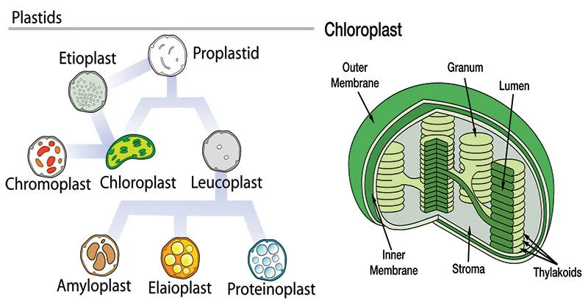
Plastids They are membrane-bound organelles that have their own DNA. They are necessary to store starch and to carry out the process of photosynthesis. It is also used in the synthesis of many molecules, which form the building blocks of the cell. Some of the vital types of plastids and their functions are stated below:
Leucoplasts
They are found in the non-photosynthetic tissue of plants. They are used for the storage of protein, lipid and starch.
Chloroplasts
It is an elongated organelle enclosed by phospholipid membrane. The chloroplast is shaped like a disc and the stroma is the fluid within the chloroplast that comprises a circular DNA. Each chloroplast contains a green colored pigment called chlorophyll required for the process of photosynthesis. The chlorophyll absorbs light energy from the sun and uses it to transform carbon dioxide and water into glucose.
Chromoplasts
They are heterogeneous, colored plastid which is responsible for pigment synthesis and for storage in photosynthetic eukaryotic organisms. Chromoplasts have red, orange and yellow colored pigments which provide color to all ripe fruits and flowers.

Slide 8
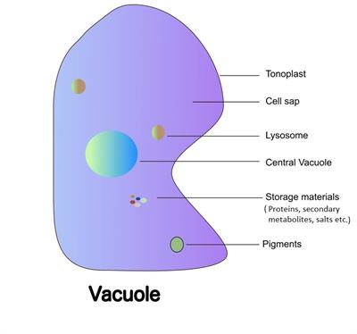
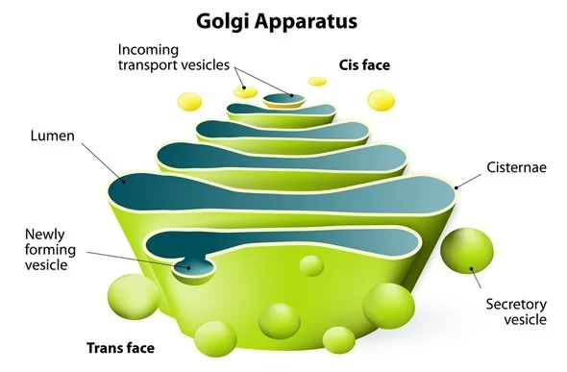
Central Vacuole
It occupies around 30% of the cell’s volume in a mature plant cell. Tonoplast is a membrane that surrounds the central vacuole. The vital function of the central vacuole apart from storage is to sustain turgor pressure against the cell wall. The central vacuole consists of cell sap. It is a mixture of salts, enzymes and other substances.
Golgi Apparatus
They are found in all eukaryotic cells, which are involved in distributing synthesized macromolecules to various parts of the cell.

Slide 9
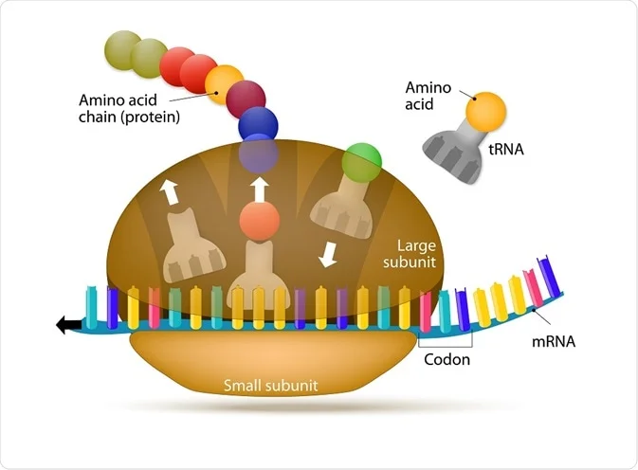
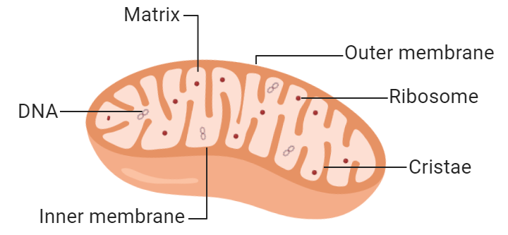
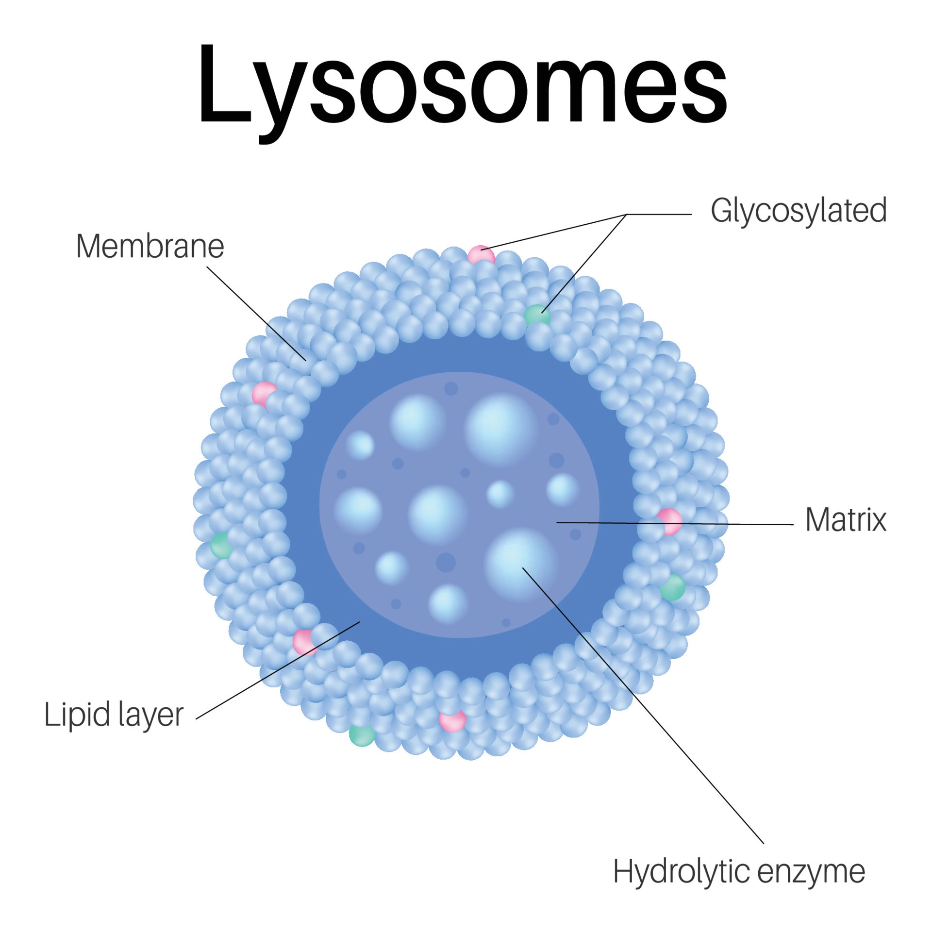
Ribosomes
They are the smallest membrane-bound organelles which comprise RNA and protein. They are the sites for protein synthesis, hence, also referred to as the protein factories of the cell.
Mitochondria
They are the double-membraned organelles found in the cytoplasm of all eukaryotic cells. They provide energy by breaking down carbohydrate and sugar molecules, hence they are also referred to as the “Powerhouse of the cell.”
Lysosome
Lysosomes are called suicidal bags as they hold digestive enzymes in an enclosed membrane. They perform the function of cellular waste disposal by digesting worn-out organelles, food particles and foreign bodies in the cell. In plants, the role of lysosomes is undertaken by the vacuoles.

Slide 10
Plant Cell Functions
Plant cells are the building blocks of plants. Photosynthesis is the major function performed by plant cells.
Photosynthesis occurs in the chloroplasts of the plant cell. It is the process of preparing food by the plants, by utilizing sunlight, carbon dioxide and water. Energy is produced in the form of ATP in the process.
A few plant cells help in the transport of water and nutrients from the roots and leaves to different parts of the plants.

Slide 11
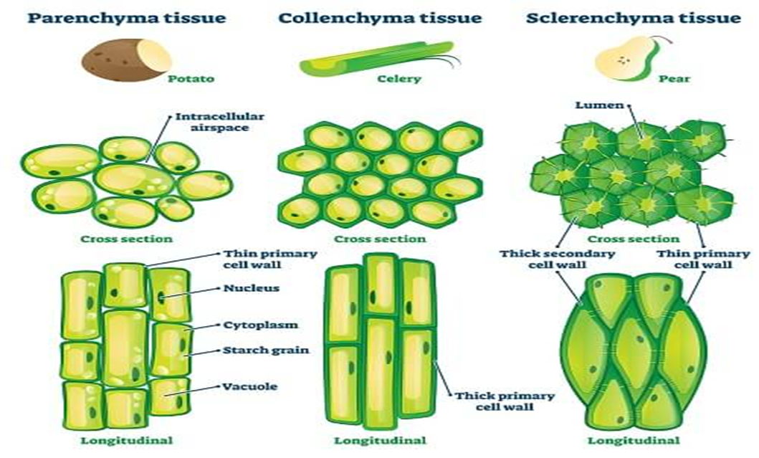

Slide 12
Plant Cell Types
Cells of a matured and higher plant become specialized to perform certain vital functions that are essential for their survival. Few plant cells are involved in the transportation of nutrients and water, while others for storing food.
The specialized plant cells include parenchyma cells, sclerenchyma cells, collenchyma cells, xylem cells and phloem cells.
Following are some of the different types of plant cells:
Collenchyma Cells
They are hard or rigid cells, which play a primary role in providing support to the plants when there is restraining growth in a plant due to lack of hardening agent in primary walls.
Sclerenchyma Cells
These cells are more rigid compared to collenchyma cells and this is because of the presence of a hardening agent. These cells are usually found in all plant roots and mainly involved in providing support to the plants.

Slide 13
Parenchyma Cells
Parenchyma cells play a significant role in all plants. They are the living cells of plants, which are involved in the production of leaves. They are also involved in the exchange of gases, production of food, storage of organic products and cell metabolism. These cells are typically more flexible than others because they are thinner.
Xylem Cells
Xylem cells are the transport cells in vascular plants. They help in the transport of water and minerals from the roots to the leaves and other parts of the plants.
Phloem Cells
Phloem cells are other transport cells in vascular plants. They transport food prepared by the leaves to different parts of the plants.

Slide 14
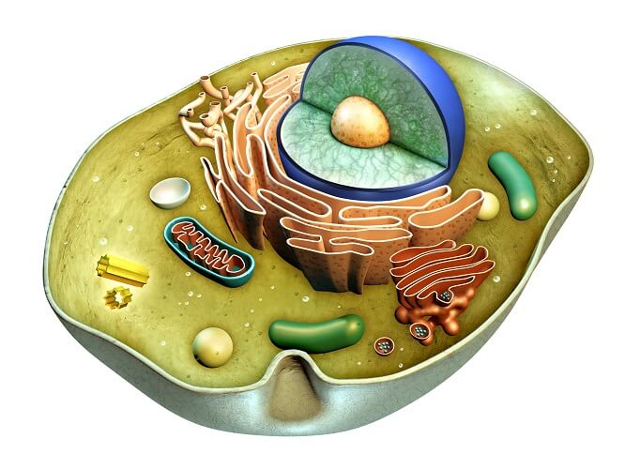
Animal cell
An animal cell is a type of eukaryotic cell that lacks a cell wall and has a true, membrane-bound nucleus along with other cellular organelles.
Animal Cell Structure
Animal cells are generally smaller than plant cells. Another defining characteristic is its irregular shape. This is due to the absence of a cell wall. But animal cells share other cellular organelles with plant cells as both have evolved from eukaryotic cells.
A typical animal cell comprises the following cell organelles:
Cell Membrane
A thin semipermeable membrane layer of lipids and proteins surrounding the cell. Its primary role is to protect the cell from its surrounding. Also, it controls the entry and exit of nutrients and other microscopic entities into the cell. For this reason, cell membranes are known as semi-permeable or selectively permeable membranes.

Slide 15
Nucleus
It is an organelle that contains several other sub-organelles such as nucleolus, nucleosomes and chromatins. It also contains DNA and other genetic materials.
primary functions of the nucleus are to store the cell's DNA, maintain its integrity, and facilitate its transcription and replication.
Nuclear Membrane
It is a double-membrane structure that surrounds the nucleus. It is also referred to as the nuclear envelope.
Centrosome
It is a small organelle found near the nucleus, which has a thick centre with radiating tubules. The centrosomes are where microtubules are produced.
Lysosome
They are round organelles surrounded by a membrane and comprising digestive enzymes which help in digestion, excretion and in the cell renewal process.
Cytoplasm
A jelly-like material which contains all the cell organelles, enclosed within the cell membrane. The substance found within the cell nucleus, contained by the nuclear membrane is called the nucleoplasm.
Golgi Apparatus
A flat, smooth layered, sac-like organelle which is located near the nucleus and involved in manufacturing, storing, packing and transporting the particles throughout the cell.

Slide 16
Mitochondria
They are spherical or rod-shaped organelles with a double membrane. They are the powerhouse of a cell as they play an important role in releasing energy.
Ribosome
They are small organelles made up of RNA-rich cytoplasmic granules, and they are the sites of protein synthesis.
Endoplasmic Reticulum (ER)
This cellular organelle is composed of a thin, winding network of membranous sacs originating from the nucleus.
Vacuole
A membrane-bound organelle present inside a cell involved in maintaining shape and storing water, food, wastes, etc.
Nucleopore
They are tiny holes present in the nuclear membrane which are involved in the movement of nucleic acids and proteins across the nuclear membrane.

Slide 17
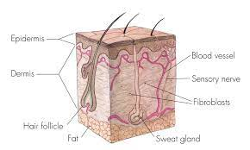
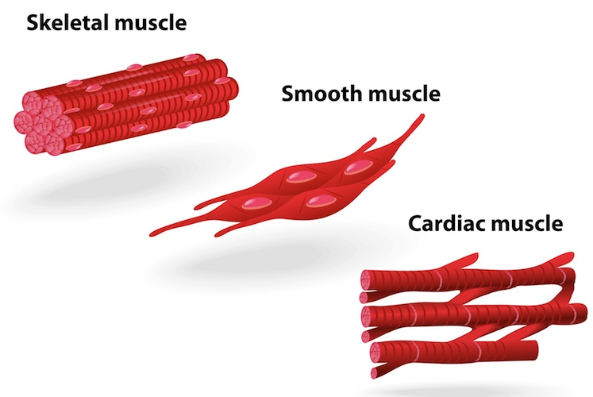
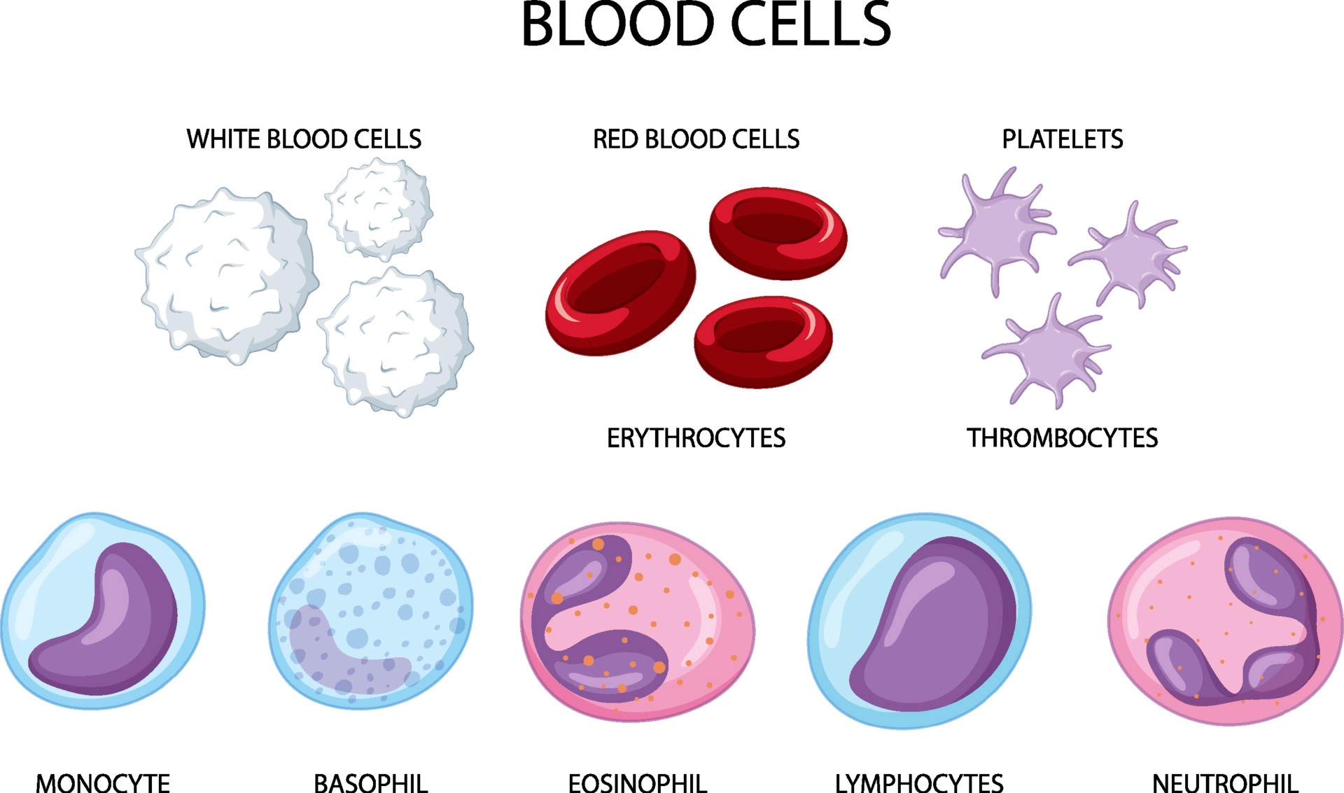
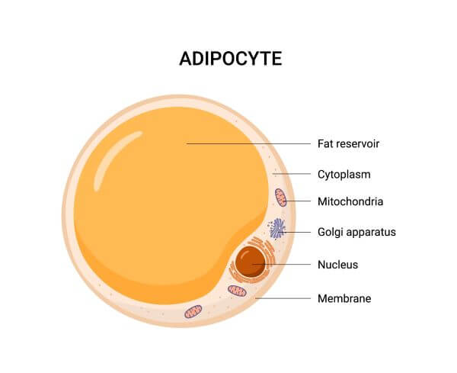
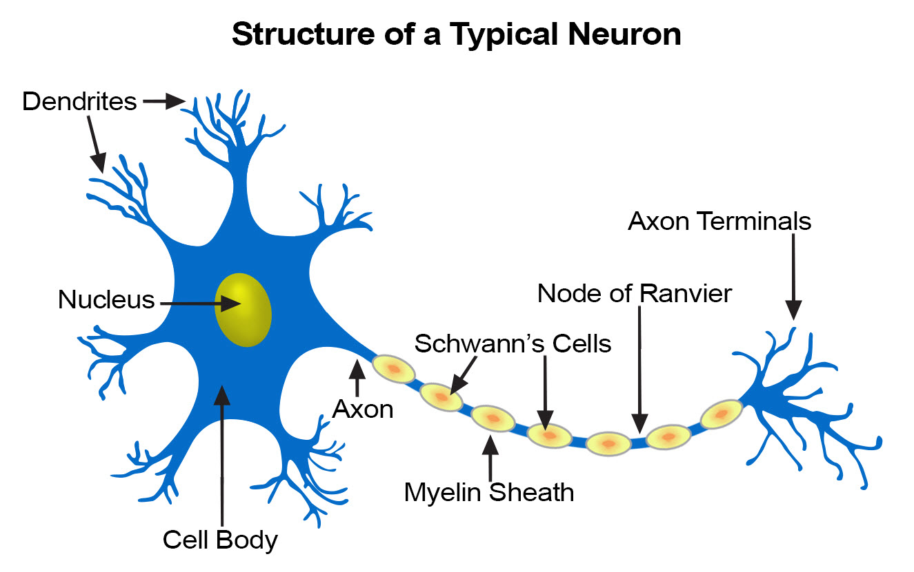
Animal Cell Types
There are numerous types of animal cells, each designed to serve specific functions. The most common types of animal cells are:
Skin Cells
Melanocytes, keratinocytes, Merkel cells and Langerhans cells
Muscle Cells
Myocyte, Myosatellite cells, Tendon cells, Cardiac muscle cells
Blood Cells
Leukocytes, erythrocytes, platelet
Nerve Cells
Schwann cell, glial cells etc
Fat Cells
Adipocytes

Slide 18
Skin Cells
Any of the four major cell types that make up the epidermis may be referred to as “skin cells.” These are the Langerhans cells, Merkel cells, keratinocytes, and melanocytes. The general structure and function of the skin are influenced by the specific functions played by each type of skin cell.
Muscle Cells
Since cardiac muscle cells and smooth muscle cells are both tiny cells, a muscle cell is also referred to as a myocyte.
Blood Cells
A blood cell, also known as a hematopoietic cell, is a type of cell that is mostly present in the blood and is created during hematopoiesis.
Nerve Cells
It is a particular kind of cell that relays information from the body to the brain and back to the body. A modest electrical current is used to transmit the messages. also known as a neuron.
Fat Cells
Adipose tissue is mostly made up of fat cells, which are adept at storing energy as fat.

Slide 19
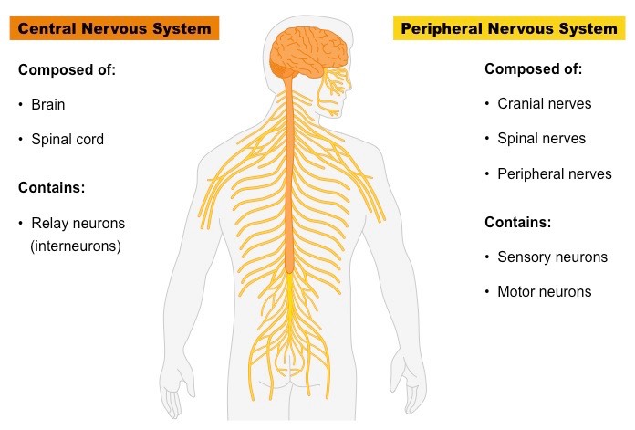

Slide 20
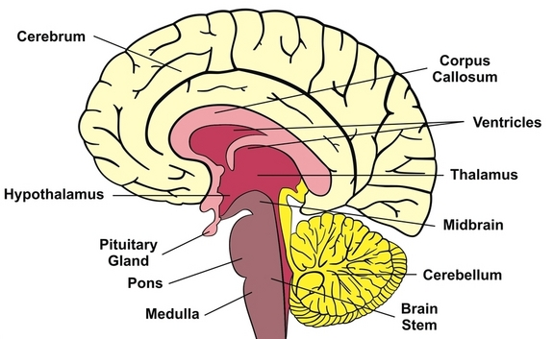
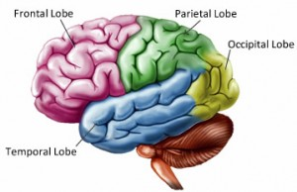
The Structure And Function Of The Human Brain
The Structure And Function Of The Human Brain
The brain structure is composed of three main parts: the forebrain, midbrain and hindbrain, each with multiple parts.
Forebrain
The Cerebrum: Also known as the cerebral cortex, the cerebrum is the largest part of the human brain, and it is associated with higher brain function such as thought and action. Nerve cells make up the gray surface, which is a little thicker than our thumb. White nerve fibers beneath the surface carry signals between nerve cells in other parts of the brain and body. Its wrinkled surface increases the surface area, and is a six-layered structure found in mammals, called the neocortex. It is divided into four sections, called “lobes”. They are; the frontal lobe, the parietal lobe, the occipital lobe and the temporal lobe.

Slide 21
Functions Of The Lobes:
Frontal Lobe – The frontal lobe lies just beneath our forehead and is associated with our brain’s ability to reason, organize, plan, speak, move, make facial expressions, serial task, problem solve, control inhibition, spontaneity, initiate and self-regulate behaviors, pay attention, remember and control emotions.
Parietal Lobe – The parietal lobe is located at the upper rear of our brain, and controls our complex behaviors, including senses such as vision, touch, body awareness and spatial orientation. It plays important roles in integrating sensory information from various parts of our body, knowledge of numbers and their relations, and in the manipulation of objects. Portions are involved with our visuospatial processing, language comprehension, the ability to construct, body positioning and movement, neglect/inattention, left-right differentiation and self-awareness/insight.
Occipital Lobe – The occipital lobe is located at the back of our brain, and is associated with our visual processing, such as visual recognition, visual attention, spatial analysis (moving in a 3-D world) and visual perception of body language; such as postures, expressions and gestures.
Temporal Lobe – The temporal lobe is located near our ears, and is associated with processing our perception and recognition of auditory stimuli (including our ability to focus on one sound among many, like listening to one voice among many at a party), comprehending spoken language, verbal memory, visual memory and language production (including fluency and word-finding), general knowledge and autobiographical memories.
A deep furrow divides the cerebrum into two halves, known as the left and right hemispheres. And, while the two hemispheres look almost symmetrical, each side seems to function differently. The right hemisphere is considered our creative side, and the left hemisphere is considered our logical side. A bundle of axons, called the corpus callosum, connects the two hemispheres.

Slide 22
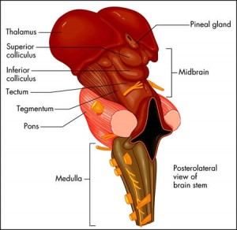
STRUCTURE OF MIDBRAIN

Slide 23
Midbrain
The midbrain is located below the cerebral cortex, and above the hindbrain placing it near the center of the brain. It is comprised of the tectum, tegmentum, cerebral aqueduct, cerebral peduncles and several nuclei and fasciculi. The primary role of the midbrain is to act as a sort of relay station for our visual and auditory systems. Portions of the midbrain called the red nucleus and the substantia nigra are involved in the control of body movement, and contain a large number of dopamine-producing neurons. The degeneration of neurons in the substantia nigra is associated with Parkinson’s disease. The midbrain is the smallest region of the brain, and is located most centrally within the cranial cavity.
Limbic System – the limbic system is often referred to as our “emotional brain”, or ‘childish brain’. It is found buried within the cerebrum and contains the thalamus, hypothalamus, amygdala and hippocampus.
Thalamus – the primary role of the thalamus is to relay sensory information from other parts of the brain to the cerebral cortex
Hypothalamus – the primary role of the hypothalamus is to regulate various functions of the pituitary gland and endocrine activity, as well as somatic functions e.g. body temperature, sleep, appetite.

Slide 24
Amygdala – the primary role of the amygdala is to be a critical processor for the senses. Connected to the hippocampus, it plays a role in emotionally laden memories and contains a huge number of opiate receptor sites that are implicated in rage, fear and sexual feelings.
Hippocampus – the primary role of the hippocampus is memory forming, organizing and storing information. It is particularly important in forming new memories, and connecting emotions and senses, such as smell and sound, to memories.
Pituitary Gland – the primary role of the pituitary gland is an important link between the nervous system and the endocrine system. It releases many hormones which affect growth, metabolism, sexual development and the reproduction system. It is connected to the hypothalamus and is about the size of a pea. It is located in the center of the skull, just behind the bridge of the nose.

Slide 25
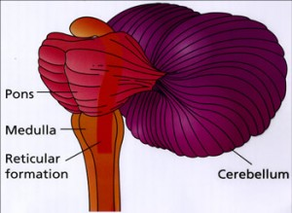
STRUCTURE OF HINDBRAIN

Slide 26
Hindbrain
The Cerebellum – The cerebellum, or “little brain”, is similar to the cerebrum with its two hemispheres and highly folded surface. It is associated with regulation and coordination of movement, posture, balance and cardiac, respiratory and vasomotor centers.
Brain Stem – The brain stem is located beneath the limbic system. It is responsible for vital life functions such as breathing, heartbeat, and blood pressure. The brain stem is made of the midbrain, pons, and medulla.
Pons – The primary role of the pons is to serve as a bridge between various parts of the nervous system, including the cerebellum and cerebrum. Many important nerves that originate in the pons, such as the trigeminal nerve, responsible for feeling in the face, as well as controlling the muscles that are responsible for biting, chewing, and swallowing. It also contains the abducens nerve, which allows us to look from side to side and the vestibular cochlear nerve, which allows to hear. As part of the brainstem, a section of the lower pons stimulates and controls the intensity of breathing, while a section of the upper pons decreases the depth and frequency of breaths. The pons is also associated with the control of sleep cycles, and controls respiration and reflexes. It is located above the medulla, below the midbrain, and just in front of the cerebellum.
Medulla – The primary role of the medulla is regulating our involuntary life sustaining functions such as breathing, swallowing and heart rate. As part of the brain stem, it also helps transfer neural messages to and from the brain and spinal cord. It is located at the junction of the spinal cord and brain

Slide 27
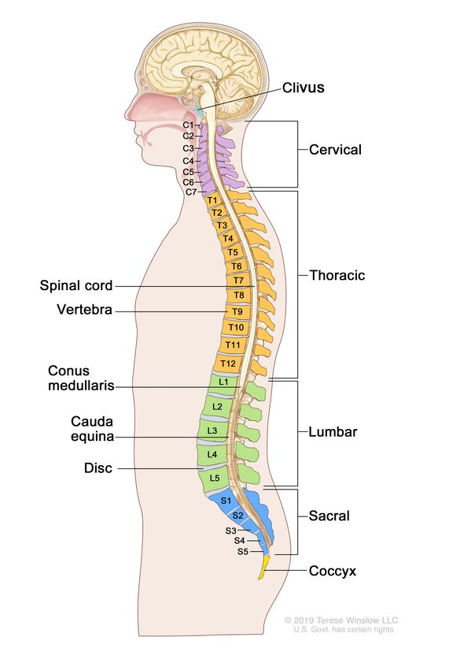

Slide 28
Spinal cord
The spinal cord is a long, tube-like band of tissue. It connects your brain to your lower back. Your spinal cord carries nerve signals from your brain to your body and vice versa. These nerve signals help you feel sensations and move your body. Any damage to your spinal cord can affect your movement or function
What is the difference between the spinal cord and the vertebral column?
People often refer to the spinal cord and vertebral column together as the spine. Your spinal cord is a band of tissues, nerves and cells. A protective layer of bone called the vertebral column covers and protects your spinal cord.
The bones in the vertebral column are called vertebrae (plural of one spine bone, a vertebra). Your vertebrae stack on top of each other, from your pelvic bones to your skull. Between each pair of vertebrae, you have a spinal disk. Disks have a tough outer shell and a gel-like interior. They act as shock absorption and cushion for your vertebrae and spinal cord.

Slide 29
What is the purpose of the spinal cord?
Your spinal cord’s main purpose is to carry nerve signals throughout your body. These nerve messages have three crucial functions.
They are :
Control body movements and functions. Signals from your brain to other body parts control your movements. They also direct autonomic (involuntary) functions like your breathing rate and heartbeat, as well as bowel and bladder function.
Report senses to your brain. Signals from other parts of your body help your brain record and process sensations like pressure or pain.
Manage your reflexes. Your spinal cord controls some reflexes (involuntary movements) without involving your brain. For example, your spinal cord manages your patellar reflex (involuntarily moving your leg when someone taps your shin in a certain spot).

Slide 30
What is the peripheral nervous system?
Your peripheral nervous system (PNS) is that part of your nervous system that lies outside your brain and spinal cord. It plays key role in both sending information from different areas of your body back to your brain, as well as carrying out commands from your brain to various parts of your body.
Some of those signals, like the ones to your heart and gut, are automatic. Others, like the ones that control movement, are under your control.
What’s the difference between the peripheral and central nervous systems?
Your nervous system consists of two main parts: your central nervous system and your peripheral nervous system. Your central nervous system includes two organs, your brain and spinal cord.
Your peripheral nervous system is everything else and includes nerves that travel from your spinal cord and brain to supply your face and the rest of your body. The term “peripheral” is from the Greek word that means around or outside the center.

Slide 31
What does the peripheral nervous system do?
Your peripheral nervous system has two main subsystems: autonomic and somatic.
Autonomic: These are nervous system processes your brain runs automatically and without you thinking about them.
Somatic: These are functions you manage by thinking about them.
Those two subsystems are how your peripheral nervous system does its three main jobs:
Senses: Your PNS is a key part of how your brain gets information about the world around you. This job falls under the somatic nervous system.
Movement: Your peripheral nerves deliver command signals to all the muscles in your body that you can consciously control. This job also falls under the somatic nervous system.
Unconscious processes: This is how your brain runs critical processes that don’t depend on your thinking about them. Examples of this include heartbeat and blood pressure. This job depends on your autonomic nervous system.

Slide 32
Types of nerve signals
Your nerves consist of bundles of nerve cells, which have long, arm-like extensions called axons. The nerve cells and their axons twist and intertwine together to form nerve fibers. This is similar to how multiple strands of spun cloth fibers twist together to form sewing thread. Some of the nerves in that bundle carry information into your brain, while others carry information out of your brain.
Sensory: These nerves carry information to your brain and spinal cord. They either connect directly to your brain through your cranial nerves or carry information to your spinal nerves, which then feed into your spinal cord. The sensory nerve connections to your spinal cord are on the back of your spinal cord.
Motor: These nerves carry command signals from your brain to various parts of your body. They only carry information away from your brain. The motor nerve connections are on the front of your spinal cord; meaning, these nerves are for sending muscle movement commands only.
Autonomic: These nerves control the automatic functions of the organs and systems in your body. Your autonomic nerves often involve mixed nerve fibers, some of which carry commands from your brain to their destination, and others that carry information about an organ’s function back to your brain.

Slide 33
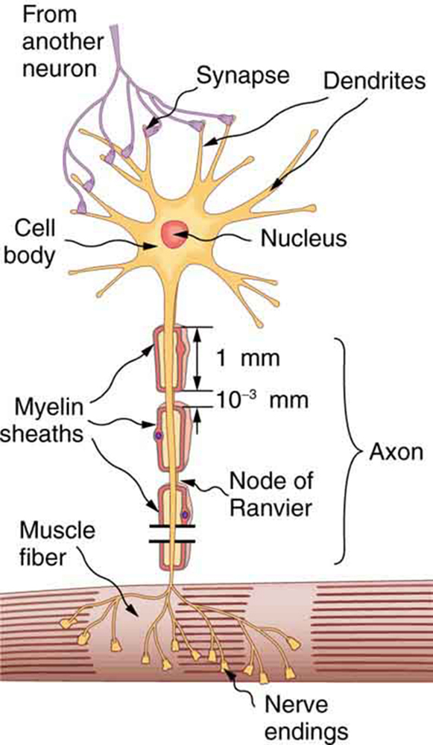
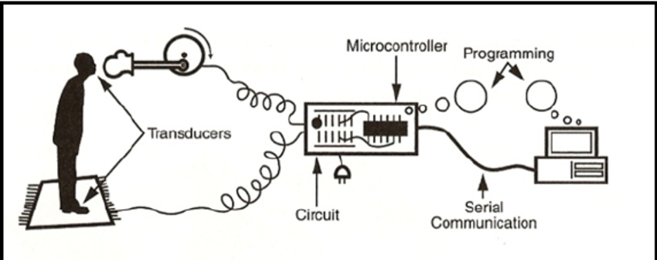
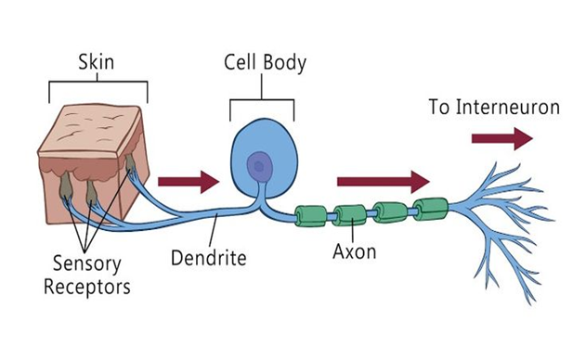
Signal Transmission

Slide 34
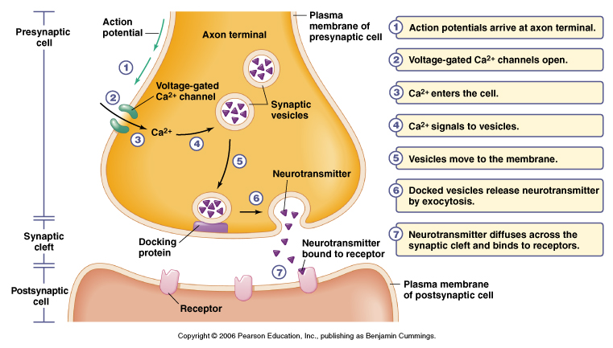
Nerve transmission (chemical)
Chemical synapses are links between neurons and non-neuronal cells (glandular cells, muscle cells, sensory cells). The synaptic complex of each chemical synapse is a non-reducible primary component that constitutes the basic minimum for chemical synaptic transmission.
It encompasses three components: the presynaptic (an axon terminal), a synaptic cleft, and a postsynaptic component (dendritic spine).

Slide 35
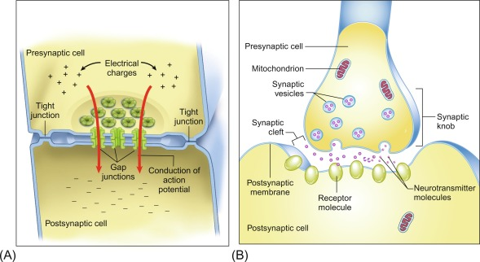
Nerve transmission (Electrical (A))

Slide 36
Electrical synapses
Electrical synapses are gap junctions. When formed between neurons, they vary from chemical synapses where the separation of the cells is not a concern. They allow current to flow directly from one cell to the next without receptors or decoding units. However, the connected cells lose some individuality, reducing their utility in big neural systems with labelled lines, such as that of mammals.
Electrical synapses are abundant in invertebrates and non-mammalian nervous systems, but they are uncommon in mammals, except for neuroglial cells in which they are the primary means of communication. They have, however, been discovered among mammalian neurons and have been shown to transmit in a few instances.

Slide 37
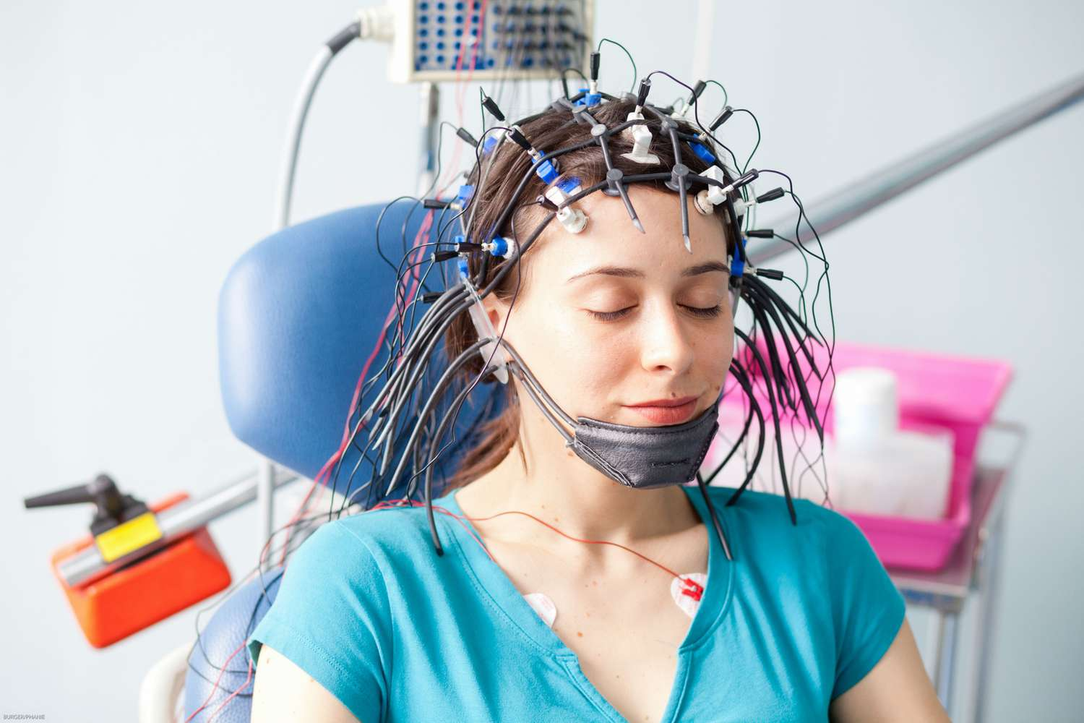
EEG(Electroencephalogram)
An EEG is a test that detects abnormalities in your brain waves, or in the electrical activity of your brain. During the procedure, electrodes consisting of small metal discs with thin wires are pasted onto your scalp. The electrodes detect tiny electrical charges that result from the activity of your brain cells. The charges are amplified and appear as a graph on a computer screen, or as a recording that may be printed out on paper. Your healthcare provider then interprets the reading.
EEGs are used to diagnose seizures related to:
Brain tumors
Brain damage from a head injury
Brain dysfunction from various causes (encephalopathy)
Inflammation of the brain (encephalitis)
Seizure disorders including epilepsy
Sleep disorders
Stroke

